Slide 1

Title slide + image
Primevision
Final Presentation
G1
Tom Bruinink
Dexin Sun
Jelmer van Gestel
Mats Poppe
Kristian Terlien

Slide 2
Contents
Introduction
Data preparation
Linear regression model
Neural network
ARIMA
LTSM/GRU
Comparison of the models
Final conclusions and recommendations

Slide 3
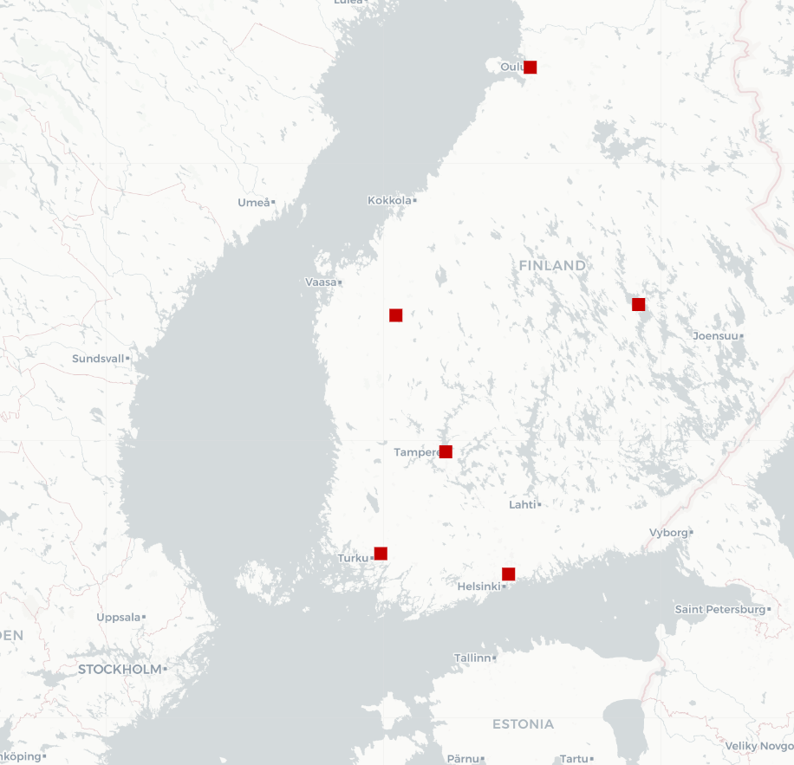
Introduction
Prediction of parcel volumes per outputbelt in 6 sorting centers in Finland
Goal: give a 14-day forecast for a given sorting center and output belt
Data of the entire year 2023
Testing models using first 9 months of the year
Forecast first two weeks of October

Slide 4
Introduction
Research question: how can time-series forecasting methods be used to predict future parcel volume in sorting centers?

Slide 5
Data preparation
Raw data
Cleaning data
One entry per sorting center/belt/date combination
Fill missing combinations with 0
Original dataset: ≈9 million entries
Cleaned data set ≈250 thousand entries
Add features
Number of day, month
Day of the week
Week of the month, week and day of the year
Entry | Sorting center | Scanning date | Output belt | No. of events
1 | VANTAA | 2023-01-05 | 88 | 9

Slide 6
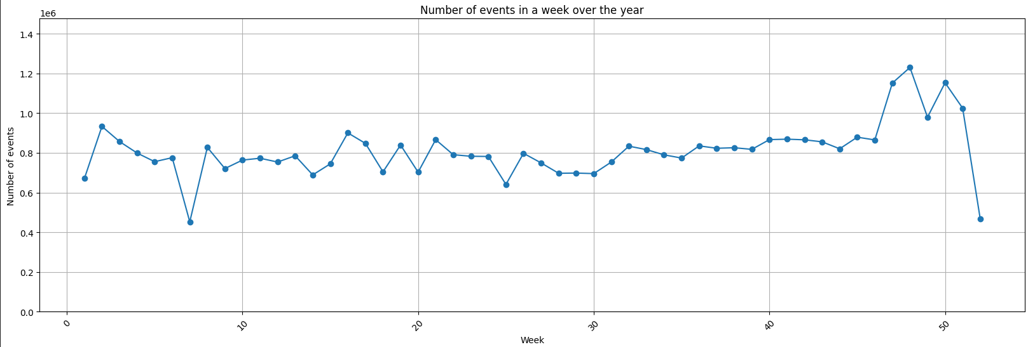
Data preparation
Higher numbers in December, but impossible to include in predictions since only one year of data was available

Slide 7
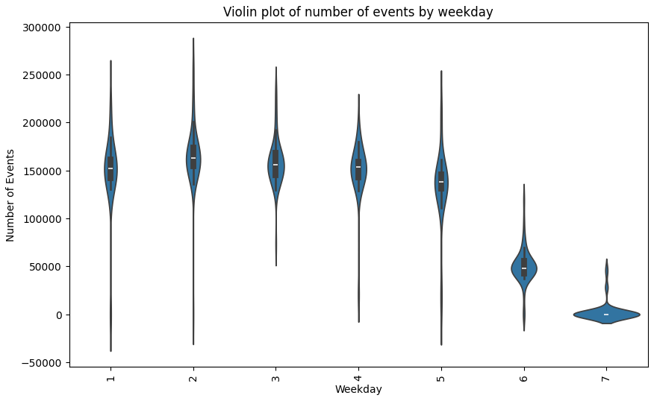
Data preparation
Main insight: weekly seasonality
Higher numbers in the beginning of the week, low numbers during the weekend

Slide 8
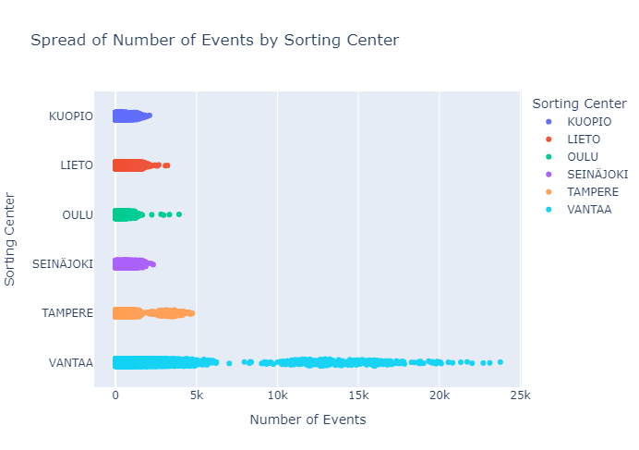
Data preparation
Outlier analysis
Highest variance for Vantaa
Vantaa is the center serving the metropolian region of Helsinki, with a population of ≈1 million

Slide 9
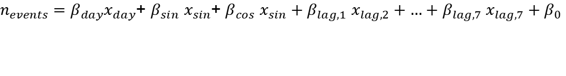
Linear regression model
Independent variables: no. of events
Used dependent variables:
Day of the week
Added features:
Lag features of the previous 7 days
Sine and cosine of the day of the week to capture seasonality
Relies on data predicted by the model itself
$n_{events}=β_{day}x_{day}$+ $β_{sin}$ $x_{sin}$+ $β_{cos}$ $x_{sin}+β_{lag,1}$ $x_{lag,2}+…+β_{lag,7} x_{lag,7}+β_{0}$

Slide 10
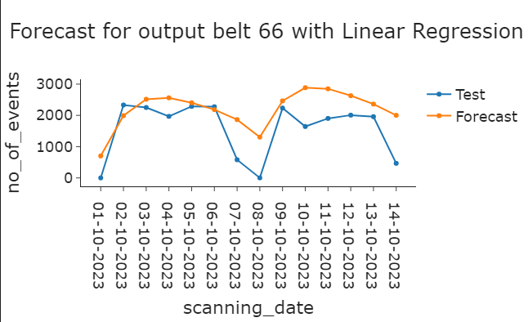
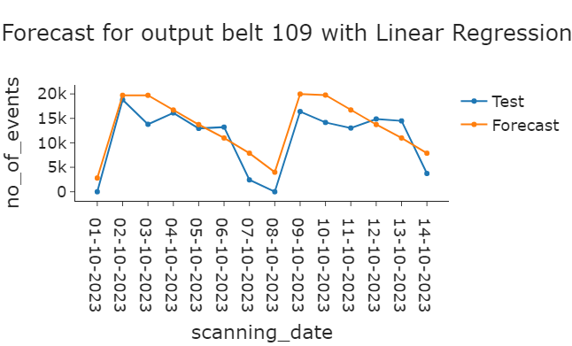
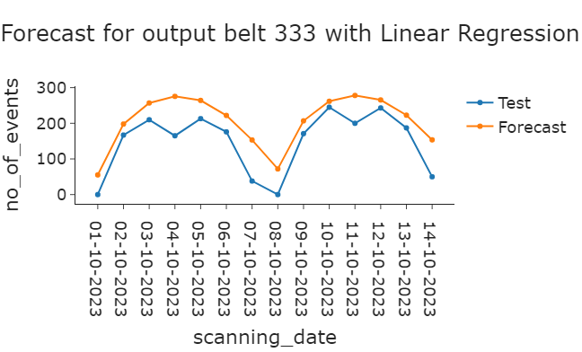
Linear regression model
Estimate a model for each output belt
Less accurate as time progresses
Vantaa examples

Slide 11
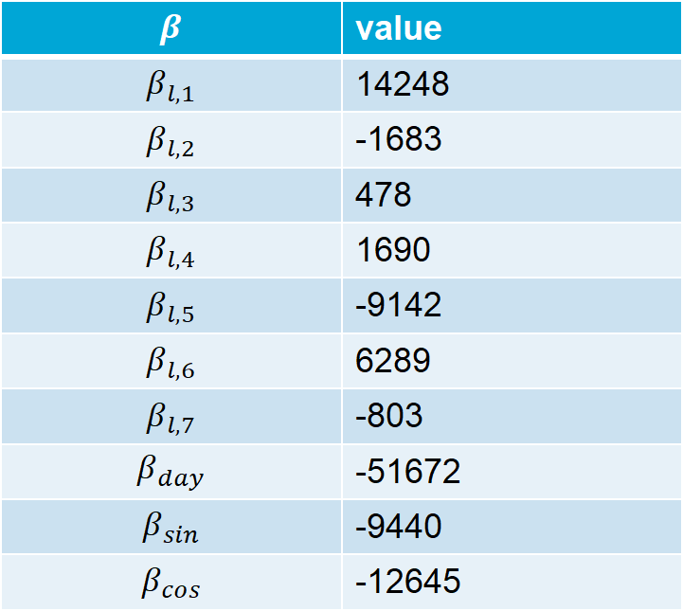
Linear regression model
$$β$$ | value
$$β_{l,1}$$ | 14248
$$β_{l,2}$$ | -1683
$$β_{l,3}$$ | 478
$$β_{l,4}$$ | 1690
$$β_{l,5}$$ | -9142
$$β_{l,6}$$ | 6289
$$β_{l,7}$$ | -803
$$β_{day}$$ | -51672
$$β_{sin}$$ | -9440
$$β_{cos}$$ | -12645
Standardised regression weights

Slide 12
Linear regression model
Sorting center | MSE | VSE | MAE
Kuopio | 10118 | 9.1e07 | 69
Lieto | 29175 | 5.3e08 | 121
Oulu | 10985 | 1.1e08 | 67
Seinjoki | 45667 | 1.7e09 | 167
Tampere | 22836 | 3.8e08 | 76
Vantaa | 275179 | 2.8e10 | 309
Total | 77812 | 2.0e09 | 138
Prediction accuracy
Mean squared error (MSE)
Variance squared error (VSE)
Mean absolute error (MAE)
Short comptutational time
Adequate results

Slide 13
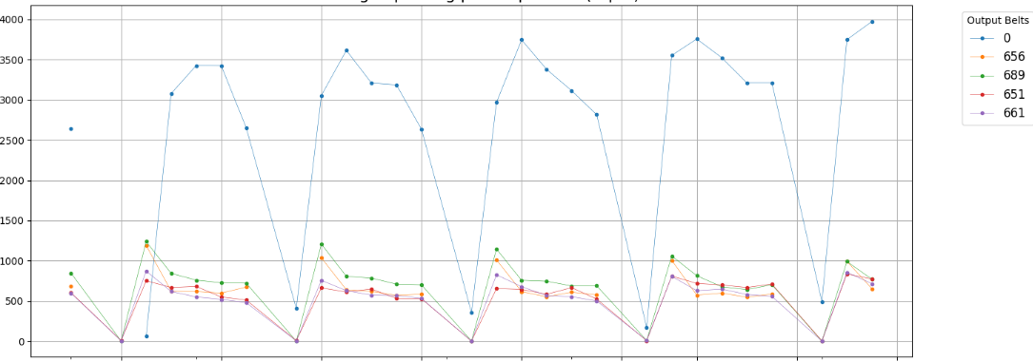
Neural network
Input features:
Output_belt
Day
Day of the week
Week of the month
Mult
Target = nr of evetns

Slide 14
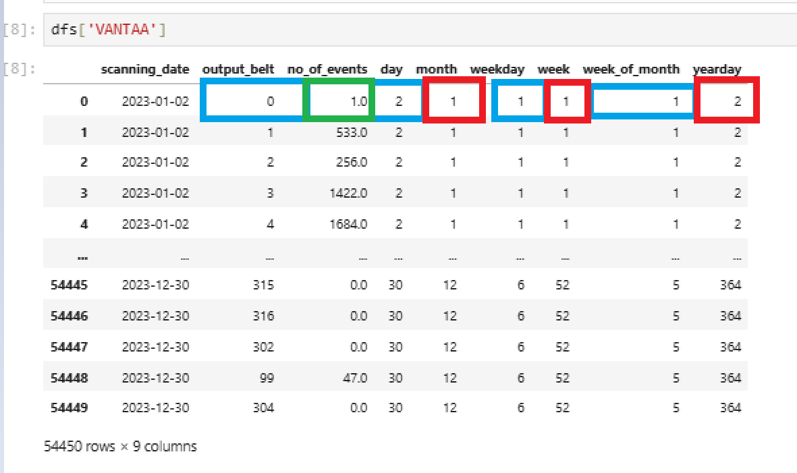
Neural network
Features
Target value
Features not taken into account ???
14

Slide 15
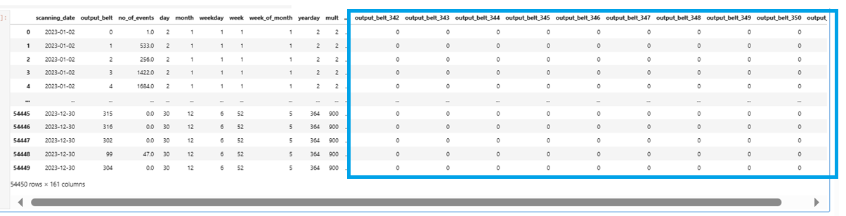
Neural network One hot encoding

Slide 16
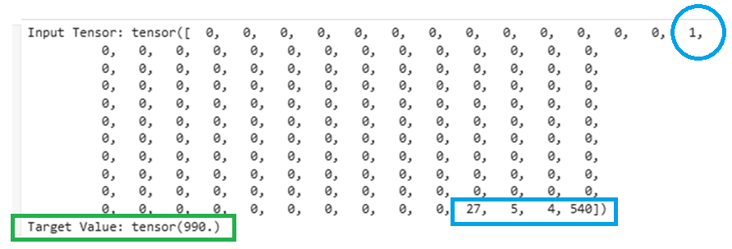
Neural network
Output belt 14
27 of the month
4 th week of the month
4 th day of the week, Thursday
Last number is a multiplication: day_of_month * week_day * week_of_moth

Slide 17
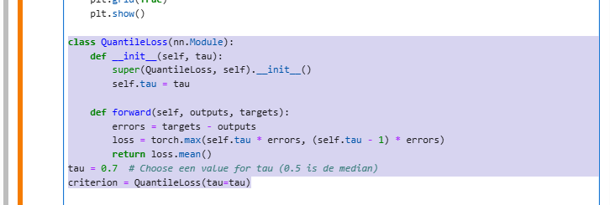
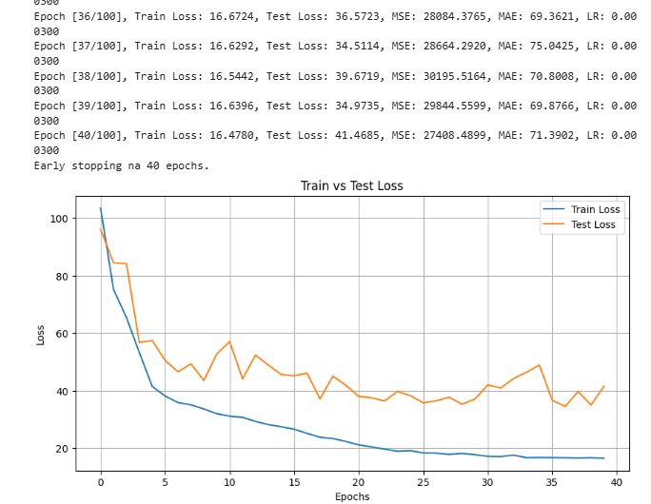
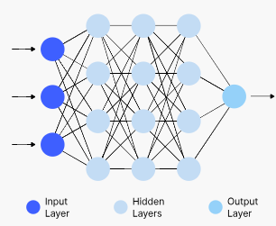
Neural neutwork

Slide 18
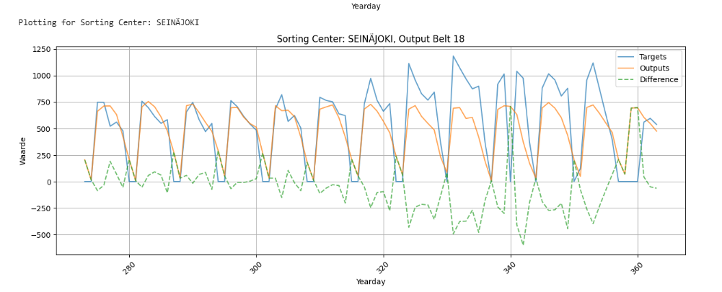
Neural neutwork results

Slide 19
Neural neutwork evalutation
Pros
Simple / straight forward
Couple minutes to train, less than a second to predict
No input data about the past required
Prediction horizon is infinity
Cons
Does not capture any increasing or decreasing trend over time
Model is quite sparse because of the one hot encoding

Slide 20
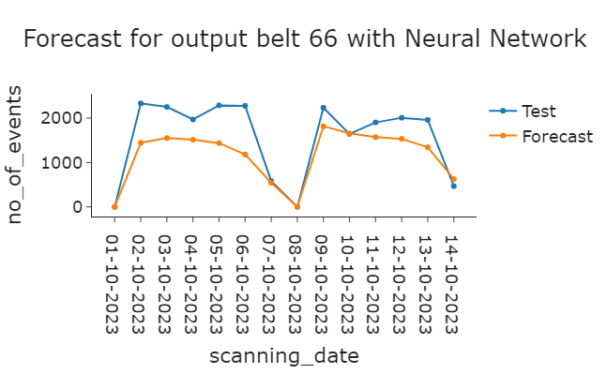
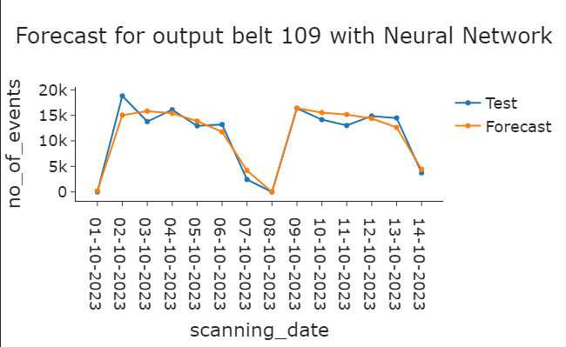
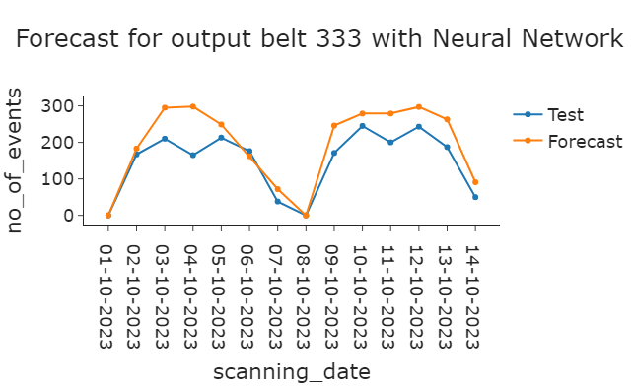
Neural network
Example forecasts

Slide 21
ARIMA
AutoRegressive (AR)
Prediction is based on previous values
Integrated (I)
Makes time series stationary
Moving Average (MA)
Prediction improved by previous forecast errors
Lagged forecasts

Slide 22
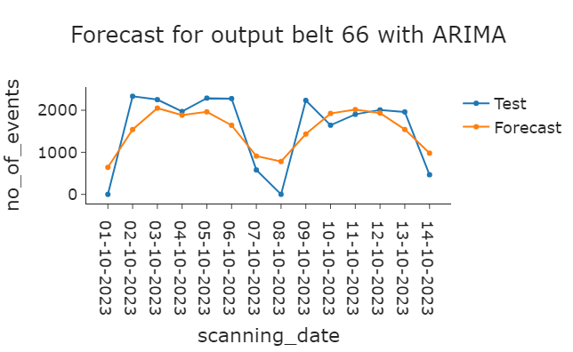
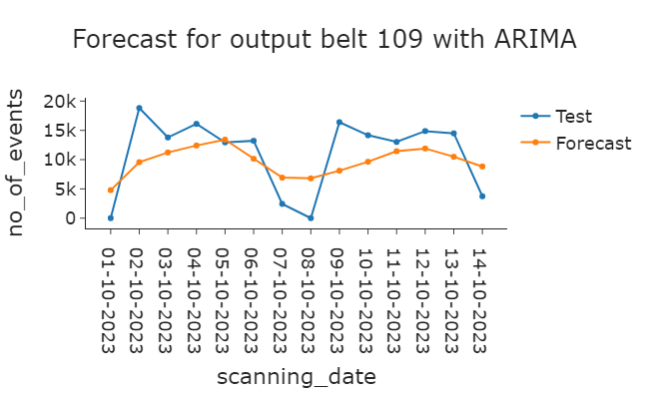
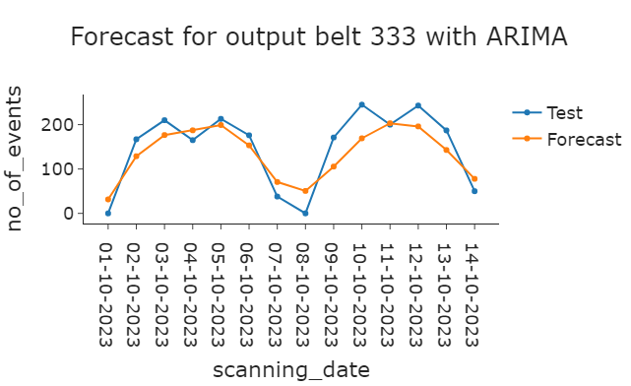
ARIMA
Model for each output belt of each sorting center
Input feature: date
Example forecasts

Slide 23
ARIMA
Most accurate forecast: Oulu
Least accurate forecast: VANTAA
MAE: on average 125 events difference between target and forecast
Sorting center | MSE | VSE | MAE
Kuopio | 9973 | 4.38e+07 | 64
Lieto | 17792 | 3.58e+08 | 86
Oulu | 10368 | 8.93e+07 | 63
Seinjoki | 50405 | 2.39e+09 | 163
Tampere | 17637 | 2.92e+08 | 77
Vantaa | 327210 | 4.78e+10 | 287
Total | 86506 | 3.21e+09 | 125

Slide 24
LSTM/GRU
Inspired by CEEMDAN: Local signal decomposition applied at each output belt level.
Signal Decomposition & Feature Extraction: Empirical Mode Decomposition/ (EMD)Wavelet Decomposition
GRU Model:Two-layer GRU with dropout and gradient clipping. Use SGD Optimizer with Cosine Annealing Learning Rate Scheduler.
Prediction & Aggregation: GRU independently predicts each IMF and wavelet component.
/ Use linear interpolation and weighted averaging to obtain the final output.
Possible Causes for the High MSE: Error accumulation through Multi-Level Decomposition and Aggregation. / Sparse Data lead to overfitting

Slide 25
Comparison of the models
Output belt 66 of sorting center VANTAA

Slide 26
Comparison of the models
Output belt 109 of sorting center VANTAA

Slide 27
Comparison of the models
Output belt 333 of sorting center VANTAA

Slide 28
Comparison of the models
Results
Neural network performs best on all performance measures
No training time Linear regression
High computation time ARIMA
Method | MSE | VSE | MAE | Running time training | Running time forecast
Linear regression | 77812 | 2.0e+09 | 138 | - | 0,19s
Neural network | 23454 | 2.1e+08 | 69 | 8m 57s | 0,02s
ARIMA | 86506 | 3.2e+09 | 126 | 14m 25s | 3m 24s

Slide 29
Comparison of the models
 | LR | NN | ARIMA | GRU/LSTM
Pros: | Short computation time | Takes a few minutes to train | Works well with data that shows a clear pattern | Extracts key features
 | Simple interpretable weights | No required input data | Interpretable parameters | Captures complex variations
 |  | Unlimited planning horizon
Cons: | Relies on previous data | Temporary variations not acounted for | High computation time | Extremely high computation time
 | Seperate estimation for each forecast | Difficult to interpret | Can only handle time series

Slide 30

Conclusions
The neural network shows the best results
Acceptable computational time
For the bigger sorting centers, predictions are less accurate

Slide 31
Afsluiter
Thanks for listening!

